Slide 1
Fitness Friend
A Modern Approach to Fitness
Group 6 Team Members: Amber Haynes, Tiyon King, Jenna Krause, Mya Odrick, Devvrat Patel, Andrew Rezk, Maria Rios, Shivani Sunil, Hedaya Walter

Slide 2

Background
Fitness Friend was created due to the following basis:
Owners of smart watches have a lower level of physical activity compared to non-owners
Fitness watches show calories lost through regular, daily movement → gives the illusion that users are losing weight
The Fitness Friend aims to overcome this by providing motivational features to encourage users to work out and consume less calories than they are losing.

Slide 3

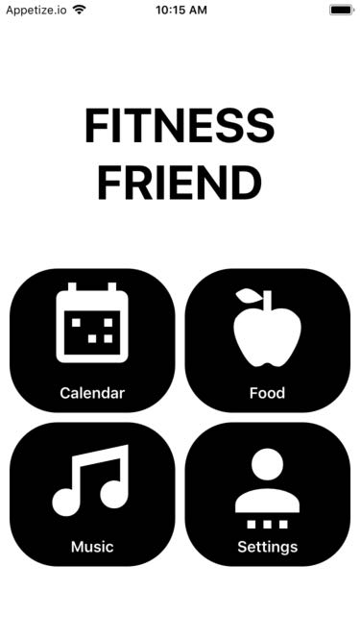
Features
Calorie Tracker & Exercise Selector
The calorie tracker allows the user to log their calories and update their calorie goals. The user can look up how many calories are in their meals or how many calories are burned during their workout.
Calendar Sync
The calendar sync feature syncs with the user’s Google Calendar to seek out any free time that may be available during the day. The feature would notify the user and suggest that a workout during this time for a predetermined interval length.
Music Curator
The music curator provides the user with BPM based playlists, via the integration of the Spotify through SDKs and APIs, to add to the overall motivational aspect of fitness. The playlists generate are based on user selected artists as well as type of workout selected.

Slide 4

Who It’s For
Target Audience: Smartwatch Owners
People who lack the motivation to workout
People who get busy in the daily schedule and consider fitness to be something that they can’t find the time for
People who want to better themselves physically
People who want to monitor what’s going into their body
This app does not promise, or guarantee, that the user will workout. Instead, it enhances the motivational aspect that comes with maintaining one’s fitness.

Slide 5
